Slide 1
February 2023 Statistical Report

Slide 4
Priority | Average of Dispatch Time | Average of Officer Travel Time | Average of Total Response Time
1 | 02:45 | 04:54 | 07:38
2 | 03:24 | 05:08 | 08:32
3 | 04:56 | 05:46 | 10:42
February Response Times

Slide 5
Overall UCR Crime View
February 22
February 23
Homicide
0
0
Rape
0
0
Robbery
2
0
Assault
6
6
Burglary
5
2
Theft
32
42
Stolen Auto
4
3
Total
49
53

Slide 6
Arrests

Slide 10
Animal Control/
Code Enforcement
Calls for Service
Animal Control | Code Enforcement | Traffic Enforcement | Total Calls for Service
32 | 25 | 39 | 96
Citations
Animal Control | Code Enforcement | Traffic Enforcement | Total Citations
3 | 3 | 33 | 39

Slide 11
Deaths
Attended 0
Unattended 2

Slide 12
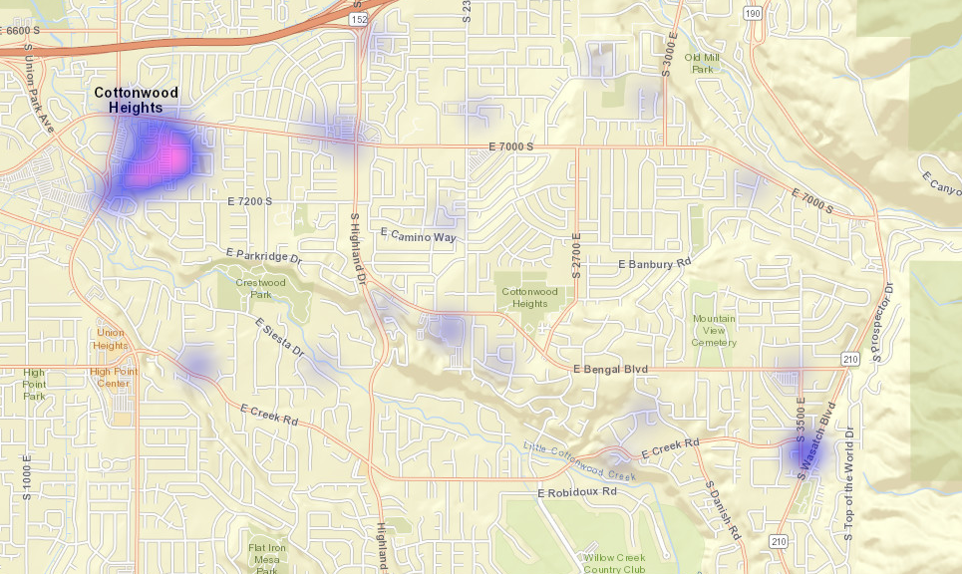
All Property Crimes Reports February 2023

Slide 13
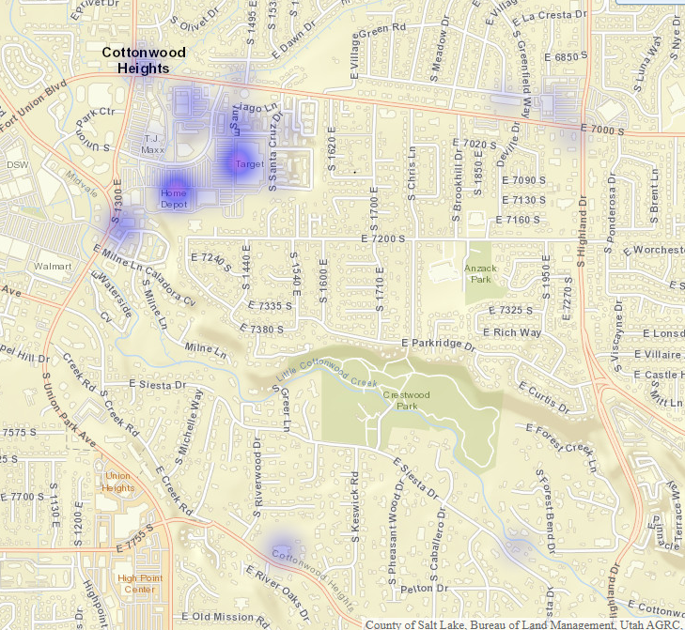
District 1
Property Crimes February 2023

Slide 14
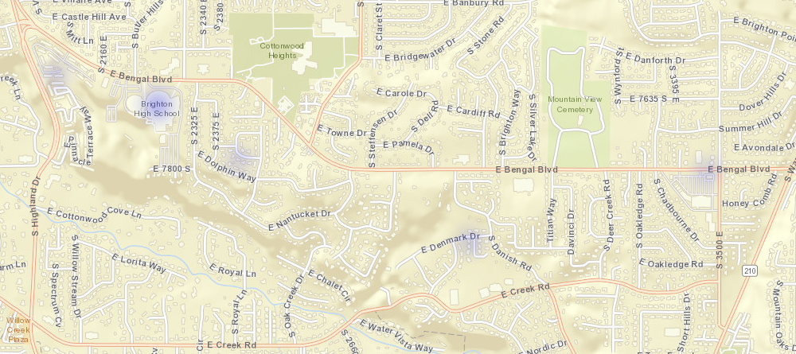
District 2
Property Crimes February 2023

Slide 15
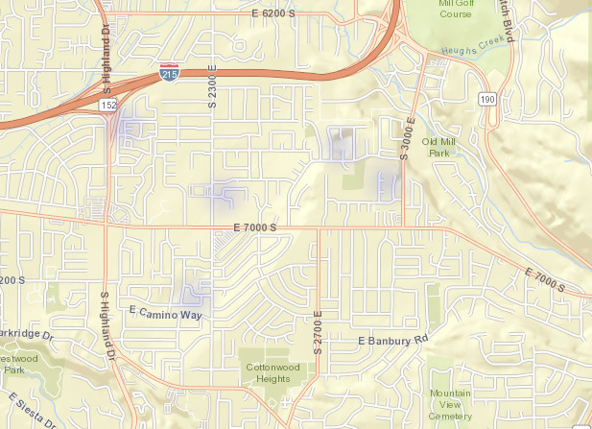
District 3
Property Crimes February 2023

Slide 16
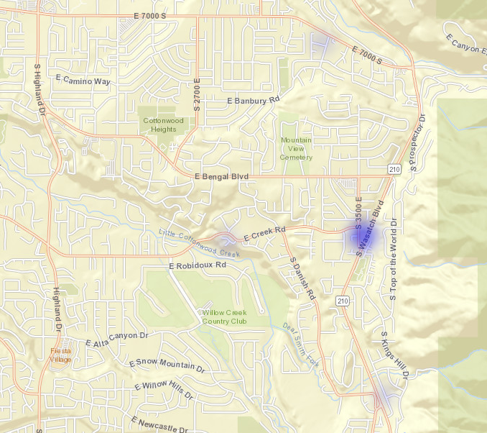
District 4
Property Crimes February 2023

Slide 17
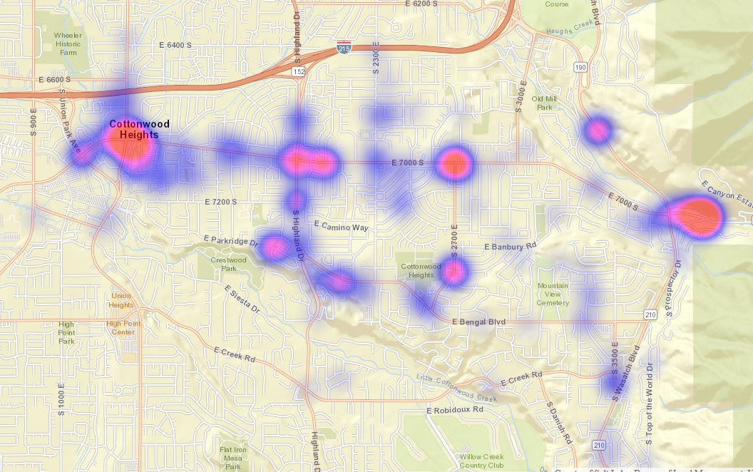
All Citations Issued February 2023

Slide 18
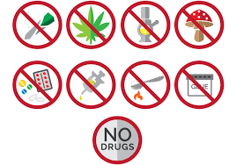
Drug Addiction Signs
Addiction can happen at any age, but it usually starts when a person is young. It’s the result of changes in the brain that can come from drug use. Addiction affects how people think and what they do. But what exactly are the signs?
First, it’s important to know that there is no “type” of person who becomes addicted. People can face addiction no matter where they’re from, what they look like, or how much money they have.
One important sign of addiction is that a person continues to use drugs even though it’s harming their life: physical health, performance at school or work, or relationships. They feel like they can’t stop using drugs, no matter what happens.
Other signs can include:
Hanging out with different friends than usual.
Not caring about their appearance.
Getting lower grades in school.
Missing classes or skipping school.
Losing interest in their favorite activities.
Getting in trouble in school or with the law.
Having different eating or sleeping habits.
Having more problems with family members and friends.
Courtesy of NIDA

