Slide 1


January 2023 Statistical Report

Slide 4
Priority | Average of Dispatch Time | Average of Officer Travel Time | Average of Total Respone Time
1 | 02:25 | 03:13 | 05:38
2 | 03:39 | 05:04 | 08:43
3 | 05:16 | 05:13 | 10:29
January Response Times

Slide 5
Overall UCR Crime View
January 22
January 23
Homicide
0
0
Rape
1
1
Robbery
0
0
Assault
10
9
Burglary
4
1
Theft
45
38
Stolen Auto
5
5
Total
65
54

Slide 6
Arrests

Slide 10
Animal Control/
Code Enforcement
Calls for Service
Animal Control | Code Enforcement | Traffic Enforcement | Total Calls for Service
41 | 26 | 19 | 86
Citations
Animal Control | Code Enforcement | Traffic Enforcement | Total Citations
5 | 5 | 16 | 26

Slide 11
Deaths
Attended 6
Unattended 1

Slide 12
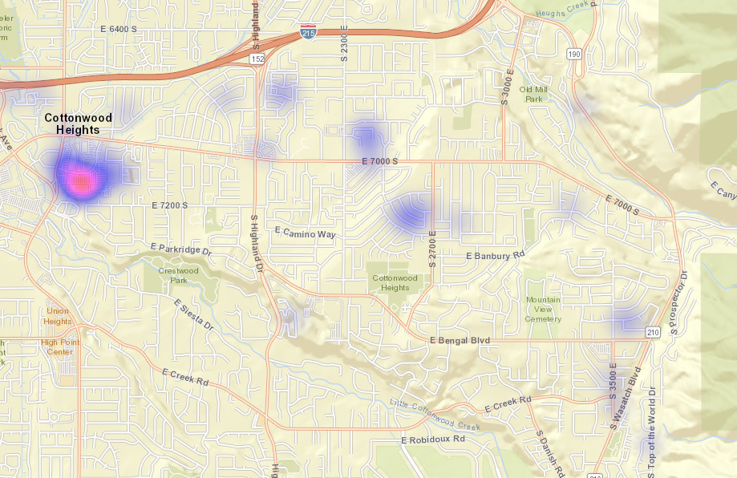
All Property Crimes Reports January 2023

Slide 13
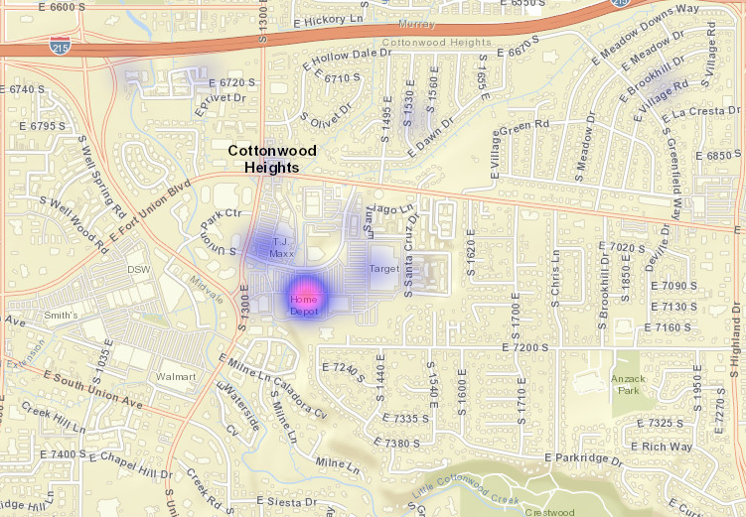
District 1
Property Crimes January 2023

Slide 14
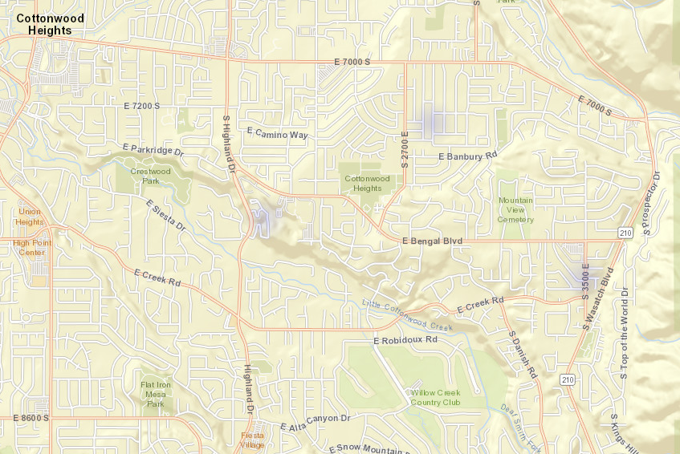
District 2
Property Crimes January 2023

Slide 15
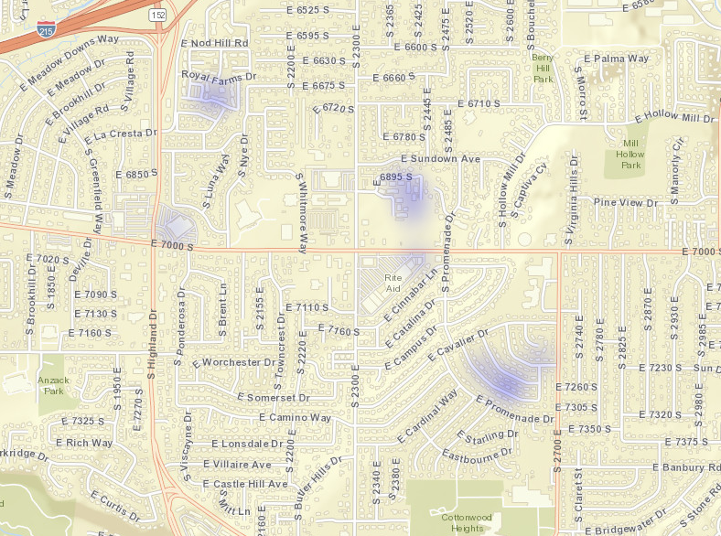
District 3
Property Crimes January 2023

Slide 16
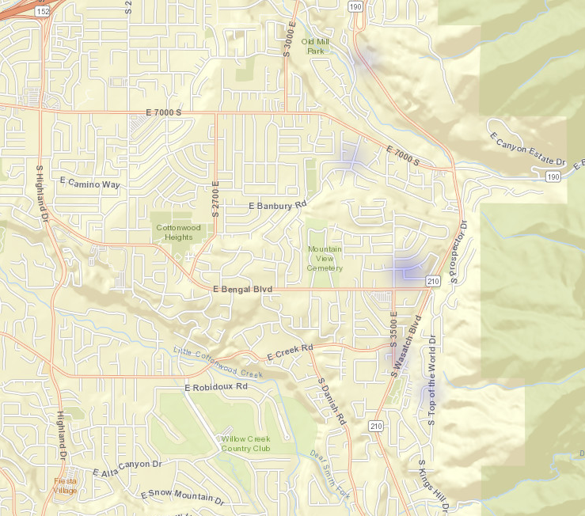
District 4
Property Crimes January 2023

Slide 17
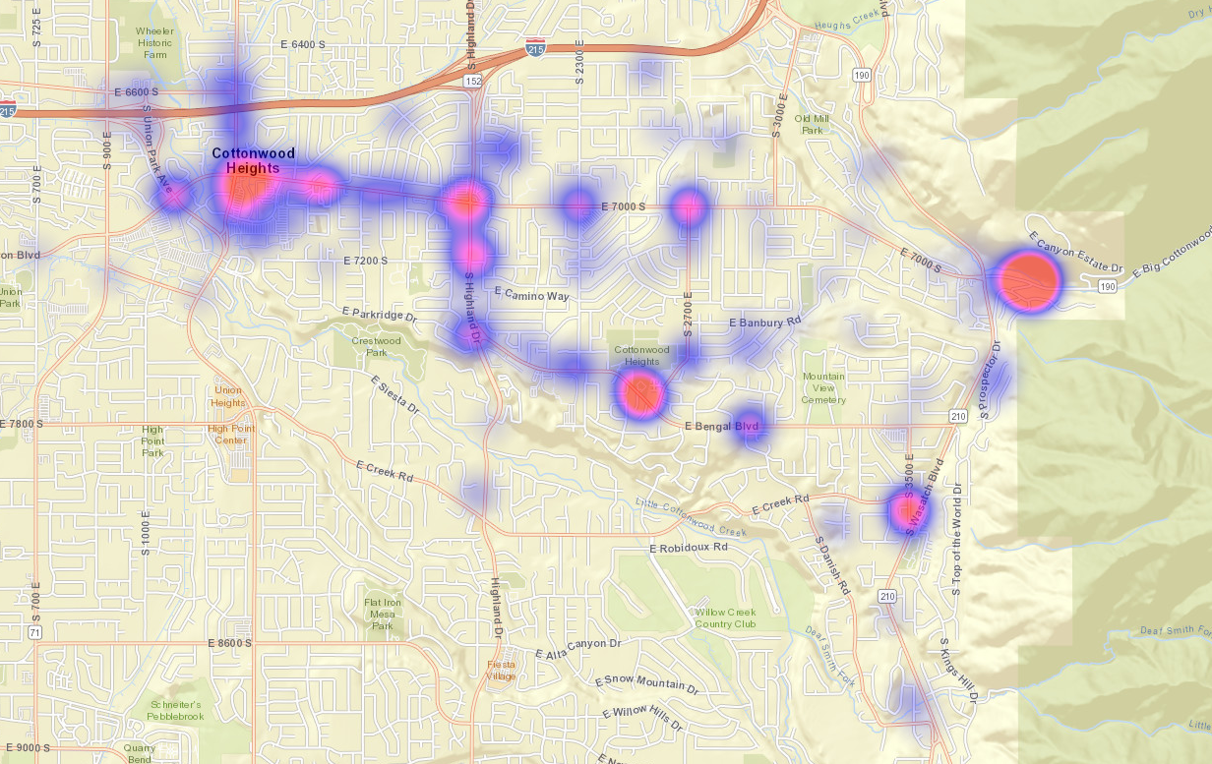
All Citations Issued January 2023

Slide 18

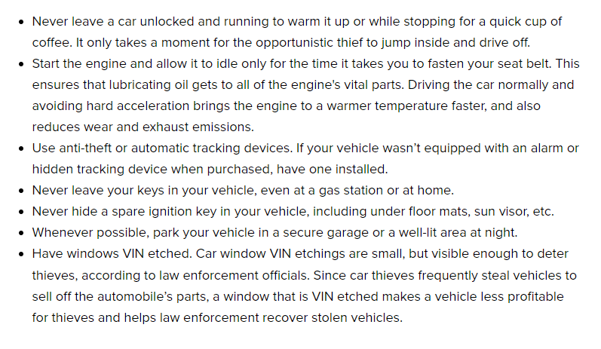
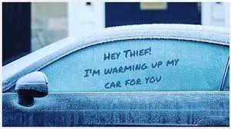
Preventing Vehicle Thefts
UC 41-6A-1403 prohibits anyone from leaving their motor vehicle unattended.

Slide 19


