Slide 1
November 2022 Statistical Report

Slide 4
Priority | Average of Dispatch Time | Average of Officer Travel Time | Average of Total Response Time
1 | 02:33 | 03:50 | 06:23
2 | 04:24 | 17:29 | 21:53
3 | 20:39 | 06:41 | 27:20
November Response Times

Slide 5
Overall UCR Crime View
November 21
November 22
Homicide
0
0
Rape
1
0
Robbery
1
0
Assault
8
3
Burglary
6
4
Theft
58
26
Stolen Auto
7
1
Total
81
34

Slide 6
Arrests

Slide 10
Animal Control/
Code Enforcement
Calls for Service
Animal Control | Code Enforcement | Traffic Enforcement | Total Calls for Service
25 | 17 | 11 | 53
Citations
Animal Control | Code Enforcement | Traffic Enforcement | Total Citations
2 | 2 | 4 | 8

Slide 11
Deaths
Attended 4
Unattended 3

Slide 12
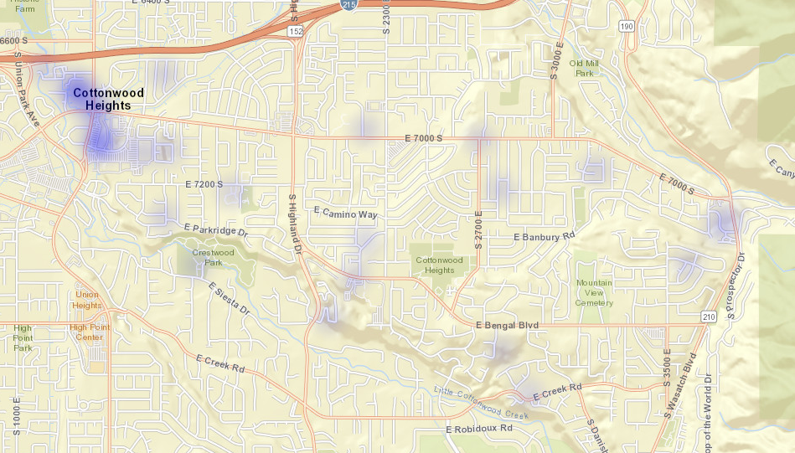
All Property Crimes Reports November 2022

Slide 13
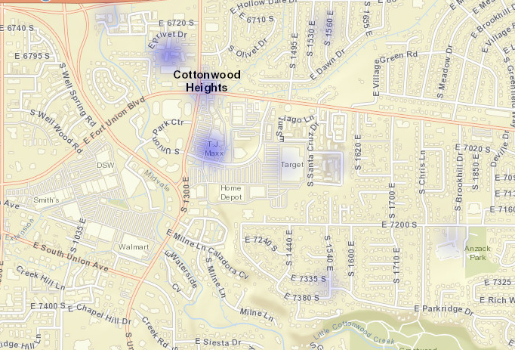
District 1
Property Crimes November 2022

Slide 14
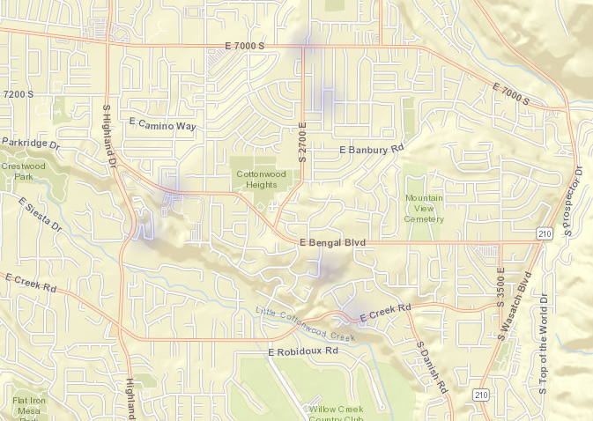
District 2
Property Crimes November 2022

Slide 15
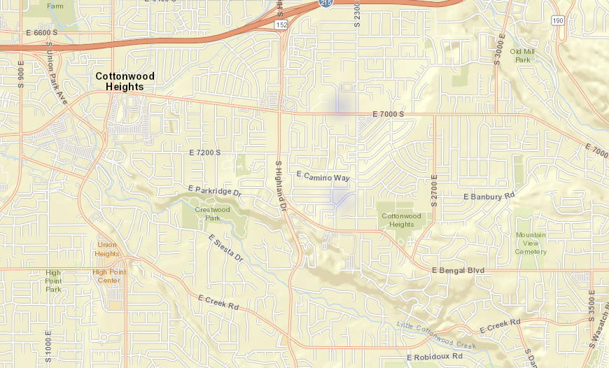
District 3
Property Crimes November 2022

Slide 16
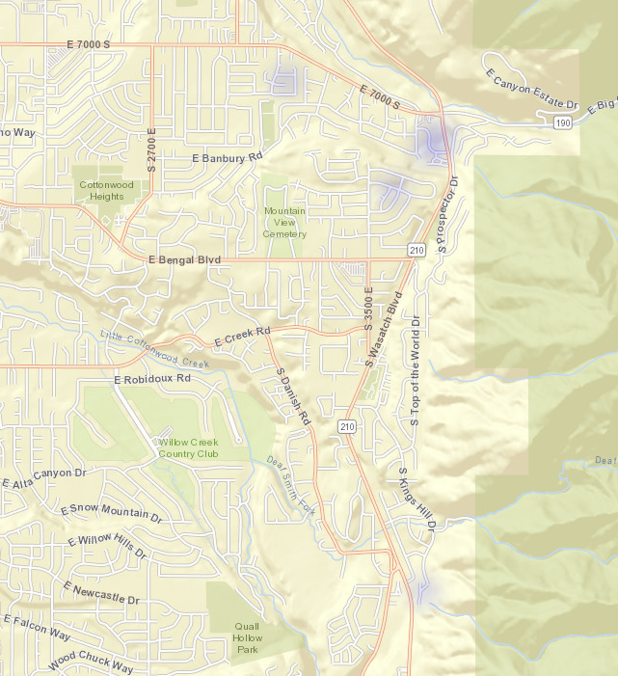
District 4
Property Crimes November 2022

Slide 17
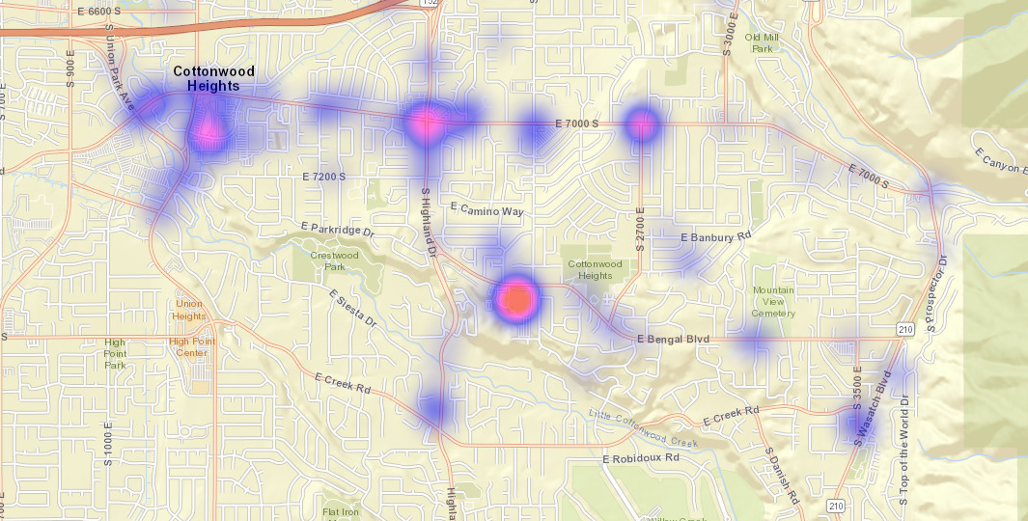
All Citations Issued November 2022

Slide 18
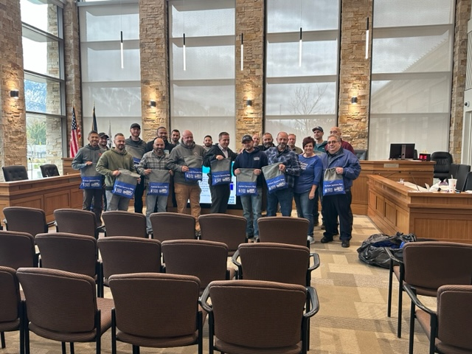
Autism Training
Our department received our yearly Autism training with Cheryl Smith from ACU.

Slide 19
Shop with a Cop

Slide 20
Drive Sober or Get Pulled Over
Drunk Driving: The Sobering Statistics
Between December 2016-2020, there were more than 4,400 people killed in drunk-driving-related crashes.
Male drunk drivers were involved in fatal crashes at a much higher rate (660) in December 2020 compared to female drivers (191).
Young people ages 21-34 accounted for the highest percentage (26%) of alcohol-impaired fatalities in December 2020.
Nighttime driving in December 2020 was significantly more dangerous than daytime driving, with 30% of drunk-driving-related crashes occurring between the hours of 6 p.m. and 5:50 a.m. Almost half (44%) occur between the hours of midnight and 2:59 a.m., likely when bars are closing, and people are driving home.
Approximately one-third of all traffic crash fatalities in the United States involve drunk drivers (with BACs at or above .08). In 2020, there were 11,654 people killed in drunk-driving crashes.
Although it’s illegal to drive when impaired by alcohol, in 2020 one person was killed every 45 minutes in a drunk-driving crash on our nation’s roads.
Men are more likely than women to be driving drunk when involved in fatal crashes. In 2020, 22% of males were drunk, compared to 16% of females.
The rate of alcohol impairment among drivers involved in fatal crashes in 2020 was 3.1 times higher at night than during the day

