Slide 1
October 2022 Statistical Report

Slide 4
Priority | Average of Dispatch Time | Average of Officer Travel Time | Average of Total Response Time
1 | 01:50 | 04:03 | 05:53
2 | 04:14 | 04:55 | 09:08
3 | 09:38 | 06:10 | 15:48
October Response Times

Slide 5
Overall UCR Crime View
October 21
October 22
Homicide
0
0
Rape
1
0
Robbery
0
0
Assault
11
4
Burglary
6
7
Theft
50
45
Stolen Auto
2
6
Total
70
62

Slide 6
Arrests

Slide 10
Animal Control/
Code Enforcement
Calls for Service
Animal Control | Code Enforcement | Traffic Enforcement | Total Calls for Service
28 | 47 | 28 | 103
Citations
Animal Control | Code Enforcement | Traffic Enforcement | Total Citations
8 | 3 | 8 | 19

Slide 11
Deaths
Attended 1
Unattended 2

Slide 12
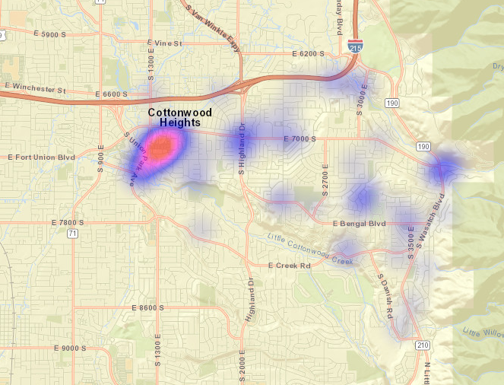
All Property Crimes Reports October 2022

Slide 13
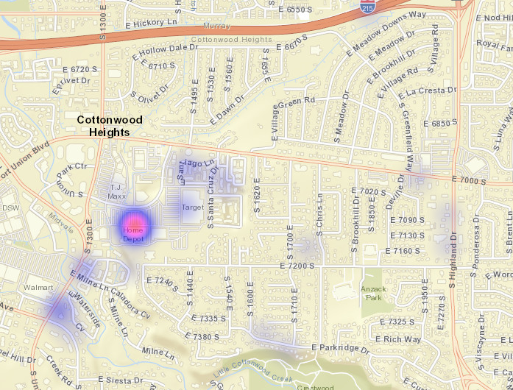
District 1
Property Crimes October 2022

Slide 14
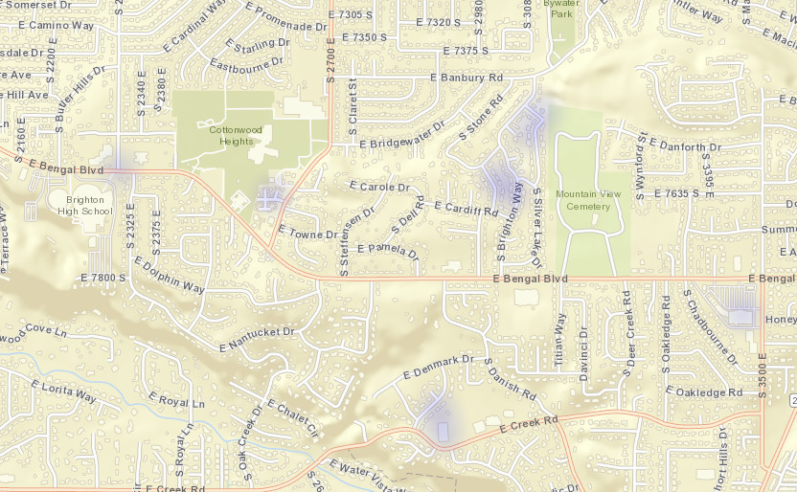
District 2
Property Crimes October 2022

Slide 15
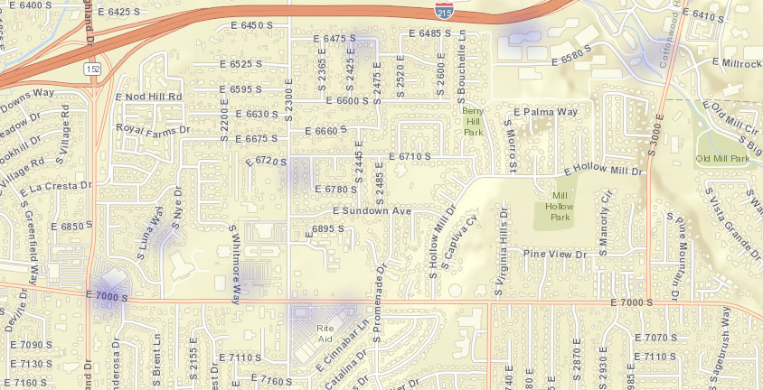
District 3
Property Crimes October 2022

Slide 16
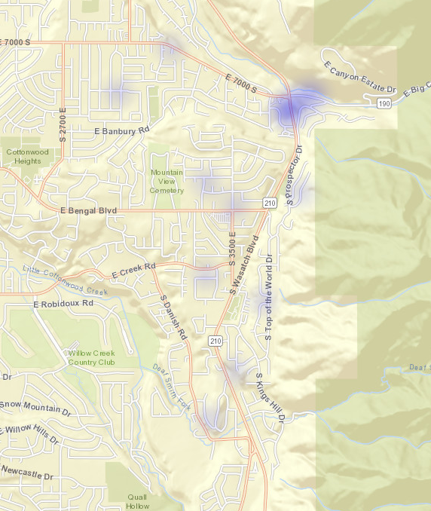
District 4
Property Crimes October 2022

Slide 17
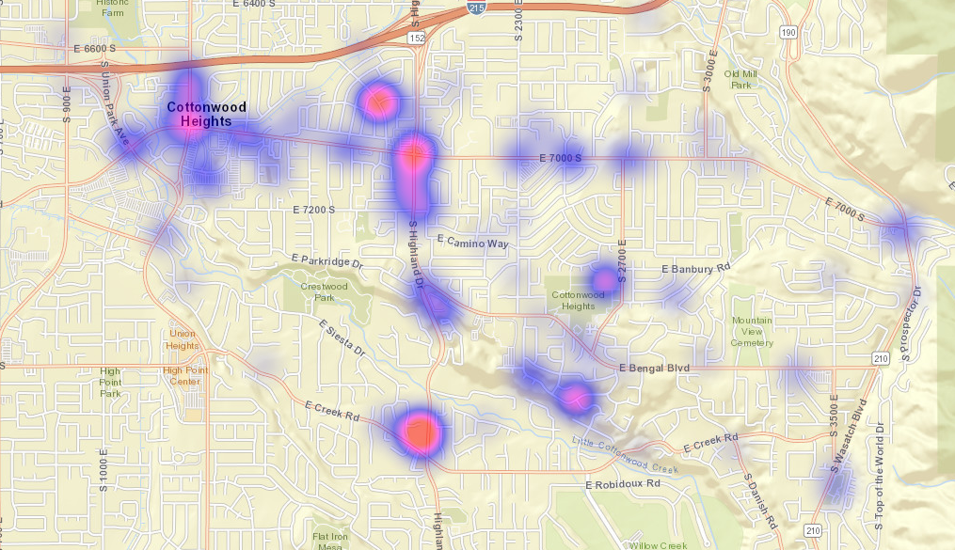
All Citations Issued October 2022

Slide 18
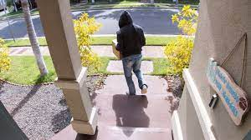
Avoiding Package Thefts
Package theft, especially around the holidays, is a growing inconvenience for many consumers. Approximately 26 million Americans say they’ve experienced a package theft, with the number increasing every year as “porch pirates” get bolder and ordering online grows in popularity.
Ship it to work
Keep your package off the porch in the first place. If your company allows, consider shipping your packages to your workplace instead of your home.
Enlist a neighbor’s help
Do you have a neighbor or a friend that’s usually home? If so, see if they can wait for your package or keep an eye out for it.
3. Require a signature
Consider requesting a signature for your package to be dropped off. That way, your package won’t be left on your porch exposed to potential thieves.
4. Be proactive
If you’re sending a package, ask the recipient to share information on the safest way for them to receive deliveries.
5. Take advantage of alternative delivery options
FedEx, the U.S. Postal Service and UPS all have alternative pickup and delivery options available.
Get technical
Consider investing in low-cost technologies like automatic light timers and motion-censored lights.
7. Keep your porch clear and visible
It may seem counter-intuitive, but if a thief has no place to hide, they’re less likely to take the risk of going up to your porch in the first place.

