Slide 1


August 2022 Statistical Report

Slide 4
Priority | Average of Dispatch Time | Average of Officer Travel Time | Average of Total Respone Time
1 | 02:00 | 03:37 | 05:37
2 | 04:42 | 05:40 | 10:22
3 | 06:51 | 05:03 | 11:54
August Response Times

Slide 5
Overall UCR Crime View
August 21
August 22
Homicide
0
0
Rape
0
0
Robbery
1
1
Assault
5
3
Burglary
8
3
Theft
55
69
Stolen Auto
8
3
Total
77
79

Slide 6
Arrests

Slide 10
Animal Control/
Code Enforcement
Calls for Service
Animal Control | Code Enforcement | Traffic Enforcement | Total Calls for Service
54 | 44 | 35 | 133
Citations
Animal Control | Code Enforcement | Traffic Enforcement | Total Citations
8 | 1 | 5 | 14

Slide 11
Deaths
Attended 2
Unattended 0

Slide 12
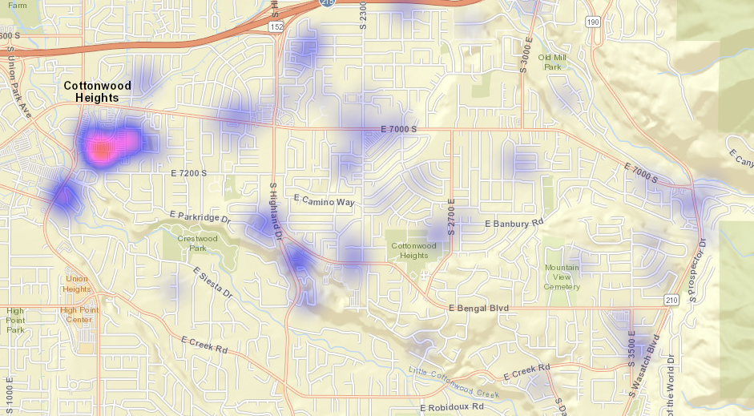
All Property Crimes Reports August 2022

Slide 13
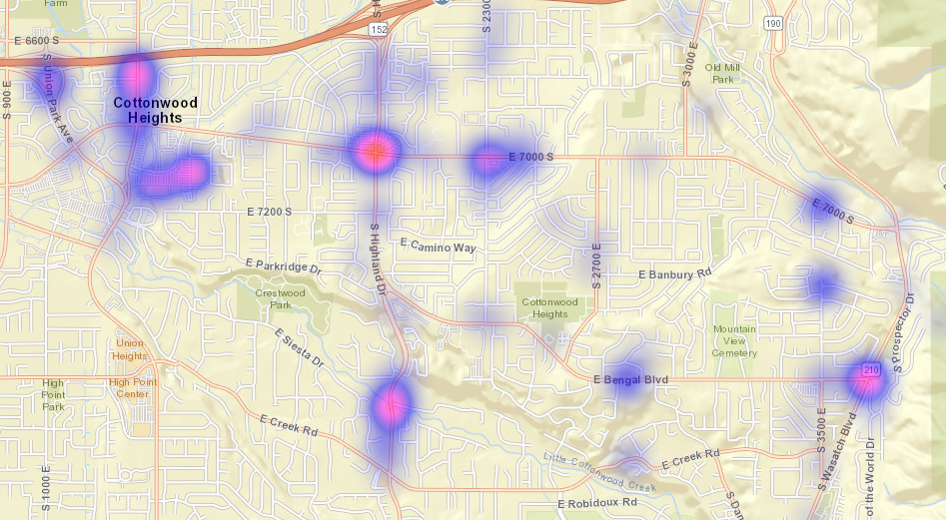
All Citations Issued August 2022

Slide 14
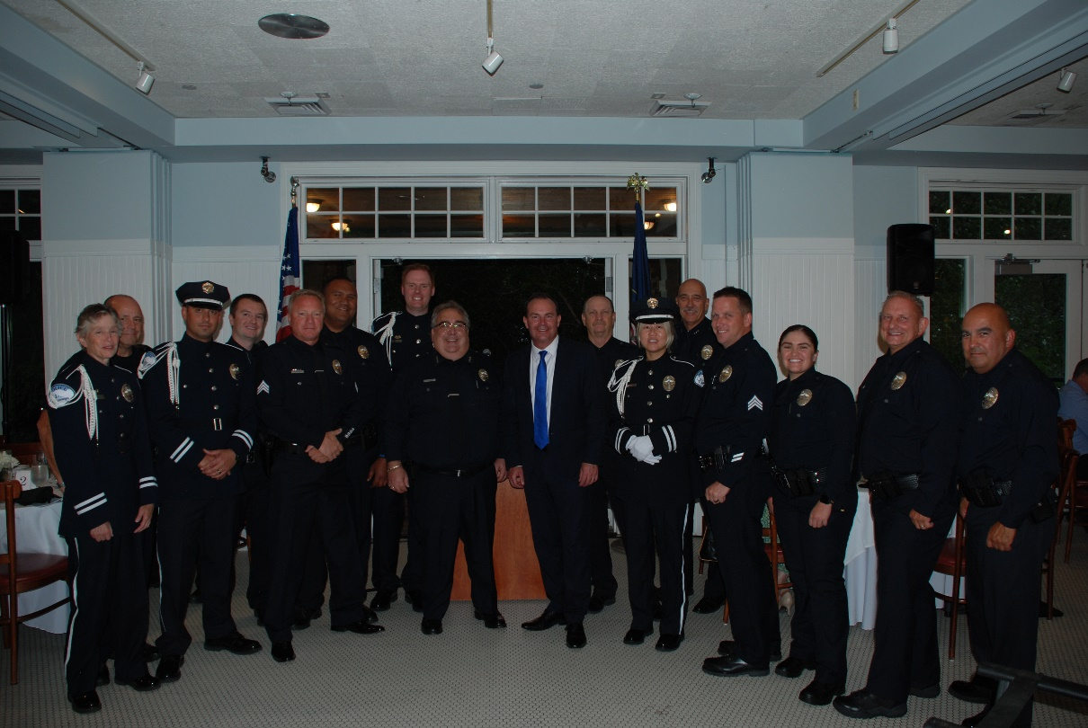
CHPD 14th Annual Awards Banquet
CHPD held their 14th Annual Awards Banquet on August 24th at Market Street Grill. Congratulations to all the award winners.
Sen. Mike Lee was the keynote speaker this year.

Slide 15

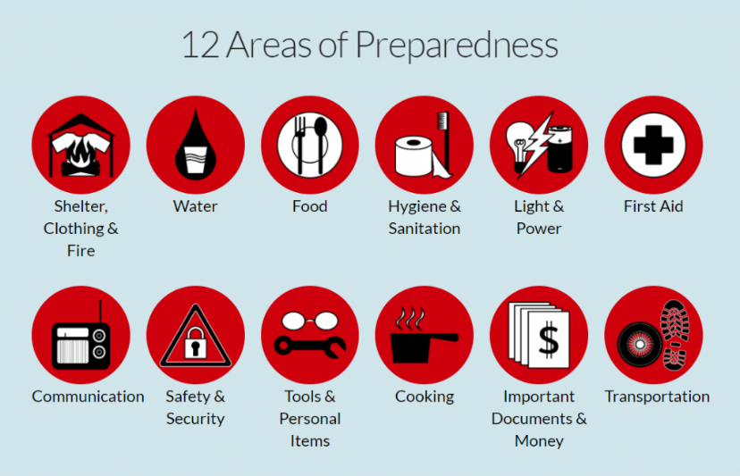
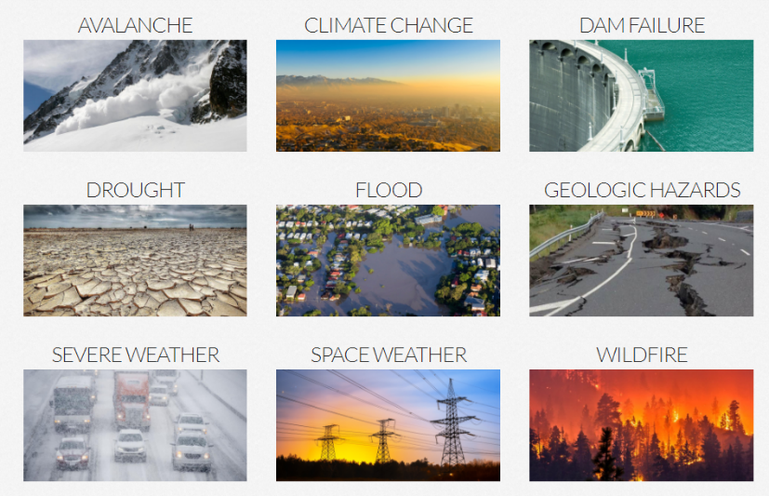
National Preparedness Month
National Preparedness Month is an observance each September to raise awareness about the importance of preparing for disasters and emergencies that could happen at any time.
This month, make it a priority to Make a Plan, Get a Kit, Be Informed, and Get Involved with Be Ready Utah.
Disaster Supply Kit
Store in a backpack, wheeled suitcase, or other portable container in an easy-access location, as near as possible to an exit
Have a separate kit for each family member
Items susceptible to water damage should be in plastic bags
Check kit twice a year and replace items that have expired or don’t work

Slide 16


