Slide 1


September 2022 Statistical Report

Slide 4
Priority | Average of Dispatch Time | Average of Officer Travel Time | Average of Total Response Time
1 | 02:16 | 04:13 | 06:28
2 | 04:33 | 05:12 | 09:46
3 | 09:47 | 05:54 | 15:41
September Response Times

Slide 5
Overall UCR Crime View
September 21
September 22
Homicide
0
0
Rape
0
1
Robbery
1
1
Assault
7
4
Burglary
7
2
Theft
56
40
Stolen Auto
11
3
Total
82
51

Slide 6
Arrests

Slide 10
Animal Control/
Code Enforcement
Calls for Service
Animal Control | Code Enforcement | Traffic Enforcement | Total Calls for Service
53 | 36 | 43 | 132
Citations
Animal Control | Code Enforcement | Traffic Enforcement | Total Citations
17 | 0 | 9 | 26

Slide 11
Deaths
Attended 2
Unattended 4

Slide 12
Three Months in Review
 | July | August | September
Calls for Service | 1473 | 1490 | 1386
On View Calls | 224 | 218 | 192
UCR | 72 | 79 | 51
Adult Arrests | 41 | 41 | 40
JV Arrests | 2 | 4 | 4
Citations | 126 | 91 | 108
Warnings | 59 | 108 | 89
DUI's | 4 | 8 | 5
Accidents | 26 | 34 | 33

Slide 13
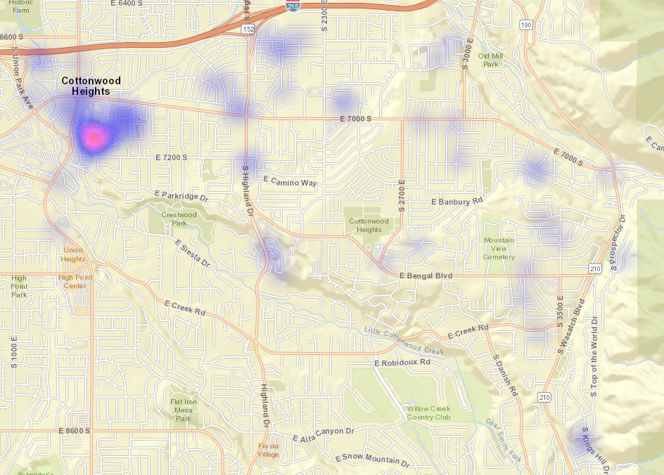
All Property Crimes Reports September 2022

Slide 14
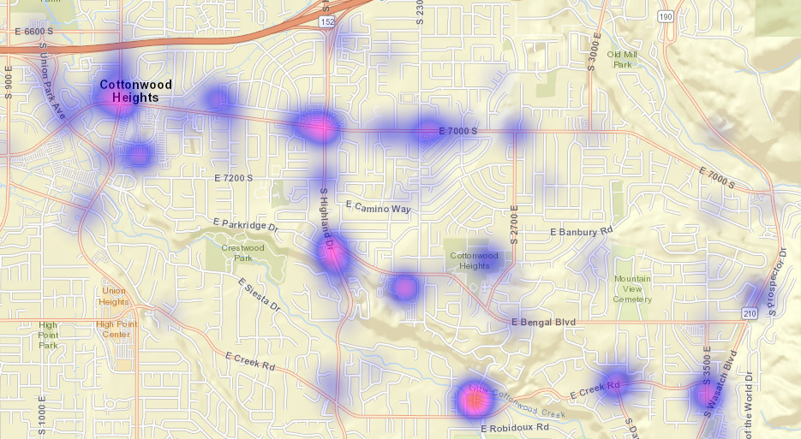
All Citations Issued September 2022

Slide 15

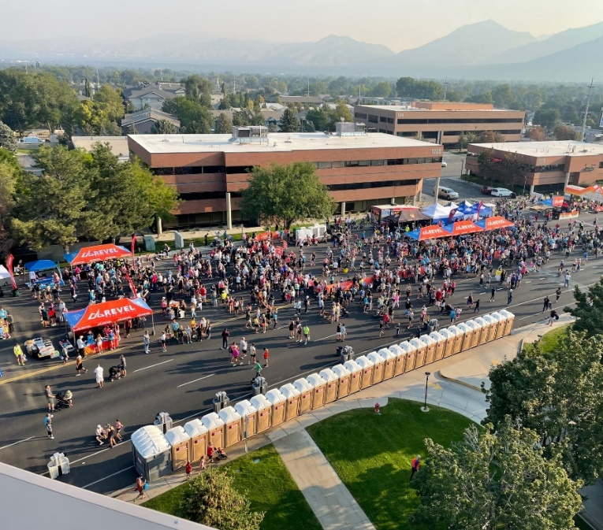
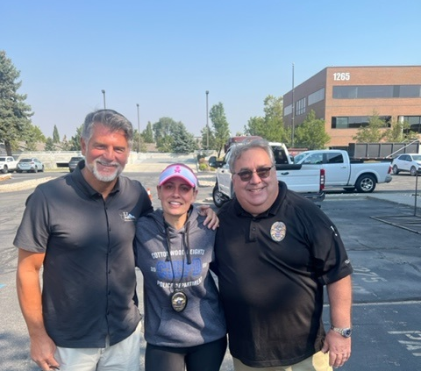
Big Cottonwood Canyon Marathon

Slide 16

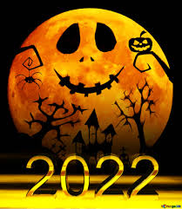
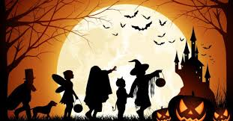
Halloween Safety
When They're on the Prowl
A responsible adult should accompany young children on the neighborhood rounds
If your older children are going alone, plan and review a route acceptable to you
Agree on a specific time children should return home
Teach your children never to enter a stranger's home or car
Instruct children to travel only in familiar, well-lit areas and stick with their friends
Tell your children not to eat any treats until they return home, and take care to avoid any food allergies
Children and adults are reminded to put electronic devices down, keep heads up and walk, don't run, across the street
Safety Tips for Motorists
Watch for children walking on roadways, medians and curbs
Enter and exit driveways and alleys carefully
At twilight and later in the evening, watch for children in dark clothing
Discourage new, inexperienced drivers from driving on Halloween

Slide 17


