Slide 1
Cottonwood Heights Emergency Management
Community / City Partnership
Ground Up Response to Emergencies

Slide 2
Emergency Response Organizations
Local / Cottonwood Heights City
County / Salt Lake County
State/ State of Utah Division of Emergency Management
Federal / Federal Emergency Management Agency
Volunteer Organizations Active if Disasters / VOADs

Slide 3
Emergency Organization
Six Major Emergency Response Districts
Covers ~90% of city residents
City Emergency Response Officials
City Emergency Manager: Paul Brenneman
GIS Specialist: Melissa Blue
CH IT Staff: Matt Ervin
City Manager: Tim Tingey
Mayor: Mike Weichers
City Council: Shawn Newell

Slide 4
Emergency Districts/Precincts

Slide 5
Precincts and Blocks

Slide 6
Block Captain Maps

Slide 7
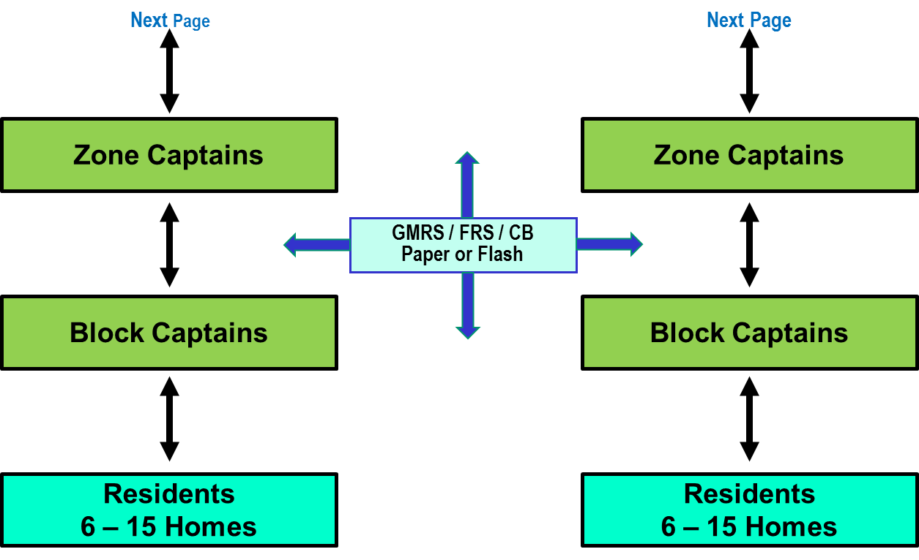
Information Flow

Slide 8
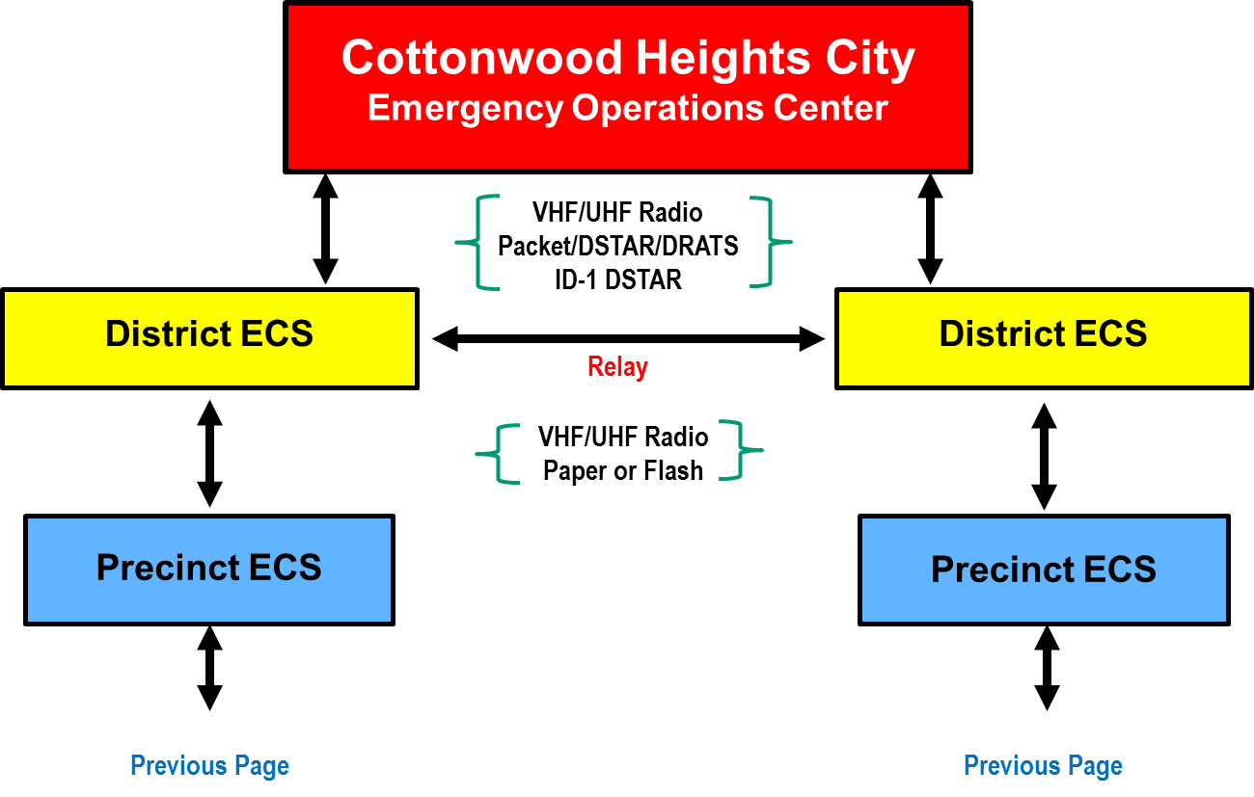
Standardization Level

Slide 9
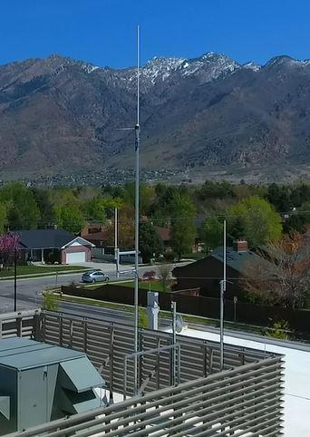
City Hall
Emergency Operations
Antennas on roof
Top quality cabling
Multiple transceivers
Backup Generator
Computers
Projection system

Slide 10
Precinct Responsibilities Pre-Event
Select or Motivate Block Captains
Identify Deputy/Assistant Precinct Leader
Identify Precinct and District Comms Persons
Identify Precinct Resources (CERT, Equipment, Medical etc.)
Work closely with District Coordinator and other Precinct Leaders

Slide 11
Precinct Responsibilities Post Event
To what extent is my/our precinct affected
What Resources do I need
What Resources do I have at my level
What resources does my district have available
Make Requests
Track Information

Slide 12
District/Precinct Decisions
How to get Red Status to District Ops
How to use ArcReader in District/Precincts
How to train Precincts to use CSV file
How to physically get flash drive to District
Radio from Precinct to District is possible
Precinct op must be licensed, have necessary radio/computer equipment

Slide 13
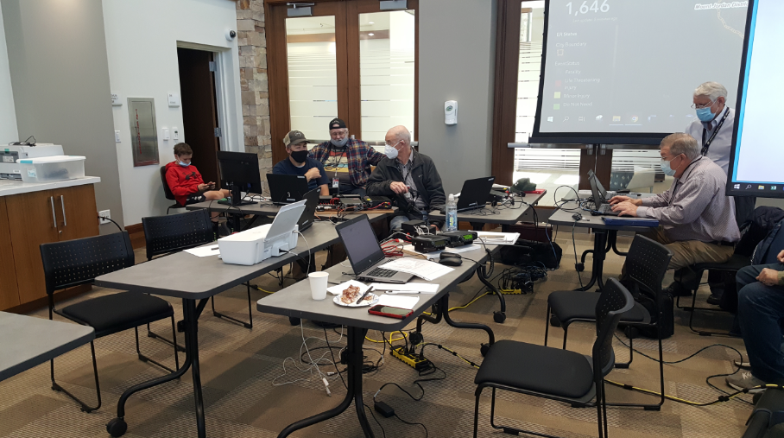
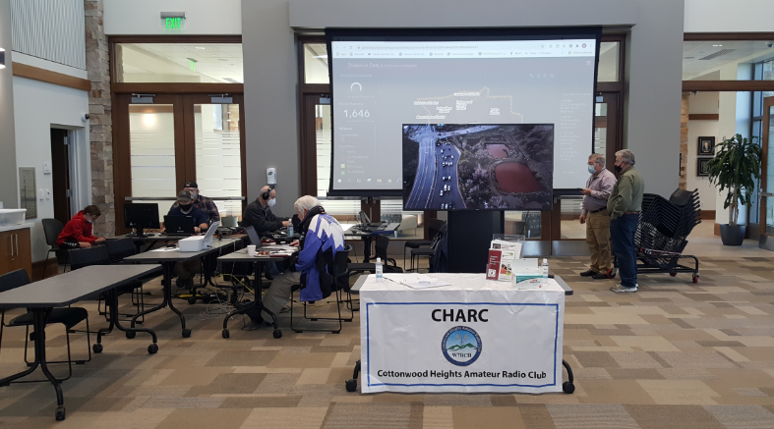
EOC Operator Positions

Slide 14
Data Handling
City provides
Maps of Districts, Precincts and blocks
Spreadsheet with residence data
Precincts
Assign/train block captains
Enter block captain data into spreadsheet on flash drive
Determine how to physically get flash drive data to District operators

Slide 15
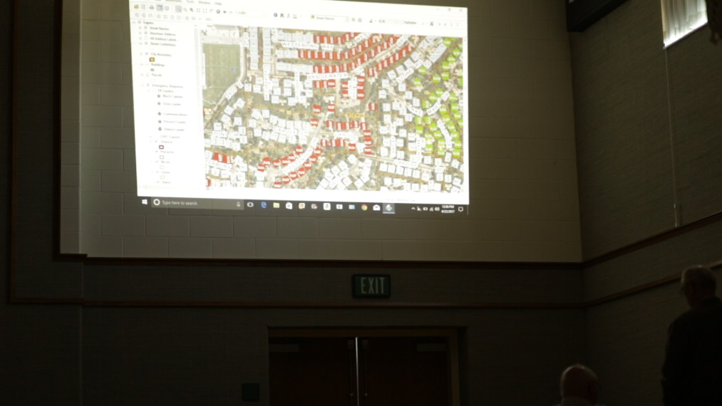
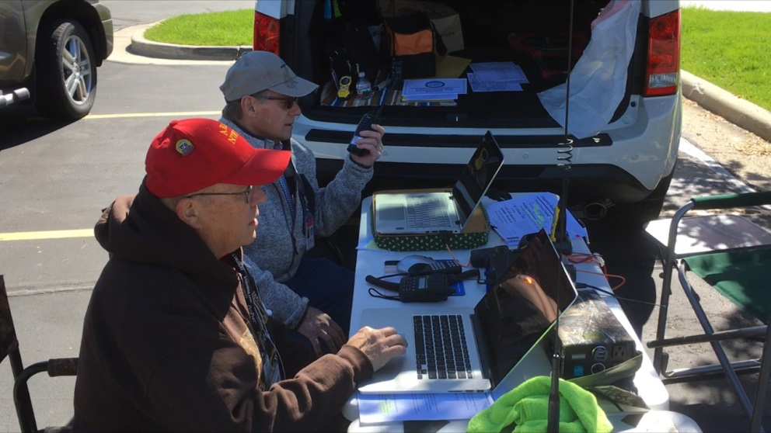
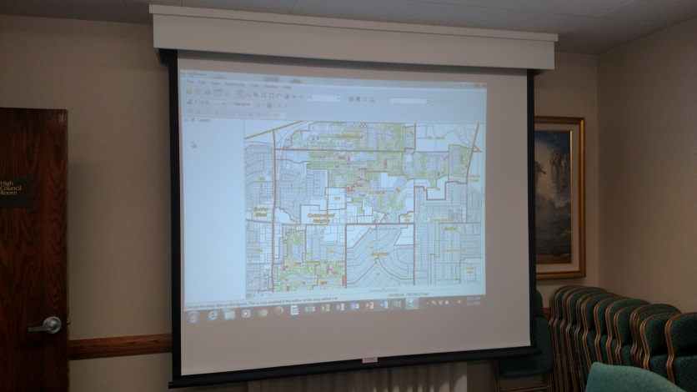
District Operations

Slide 16
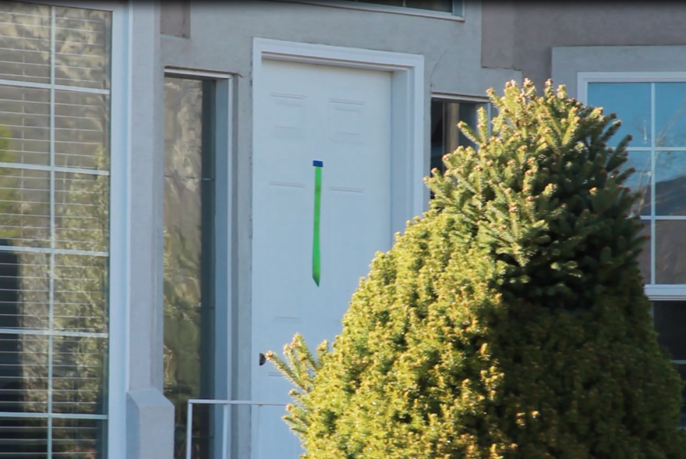
Residence Status Ribbon

Slide 17
Gathering Data

Slide 18
Ribbon Data Flow
Residences place colored ribbons on a visible location
Block Captains collect and document ribbon color for delivery to Precinct Communication Specialist
Precinct Communication Specialist compiles data in the proper format for delivery to the District Communications Specialist
District Communications Specialist checks the compiled data for format accuracy and delivers it to the Emergency Operations Center (EOC)
The EOC receives the data and forwards it to the GIS Tech for entry

Slide 19
End Result

Slide 20
Original CSV File Format

Slide 21
Completed CSV File Format

Slide 22
Red Status Process
Block captains, precinct ops get Red Status data to District ASAP
District Operators have special channel set up for Red Status
EOC has dedicated operator for Red Status
Information passed to Incident Command immediately upon receipt

Slide 23
Precinct Operators
Precinct Communications Operator
Works with District Op on data handling processes
Collects residence color data from Block Captains
Enters data into CSV spreadsheet on flash drive
Gets flash drive to District Operator

Slide 24
District Operators
Maintain fully functional radio station
Radio drills quarterly
Work with District/precinct leaders
Devise procedures for data handling
Receive Precinct csv status files
Inform EOC when precinct files available
Train district/precinct personnel
CSV file preparation, ArcReader software use

Slide 25
ArcReader Software
Graphic display of residence status
Basically identical to EOC map display
Input Precinct status as it’s gathered
Allows Precincts and Districts to know how to respond in their neighborhoods
VITAL TOOL FOR PRECINCT AND DISTRICT EMERGENCY PERSONNEL

Slide 26
Butler District Shakeout 2022

Slide 27
CHARC Information Provided
GIS Map with residence status color
Expedited reports of Red Status locations
List of districts/precincts Reporting
Streaming video, audio reports from Rec Center Mass Shelter Site
Images sent by cellphone, if Internet is available
Images sent by radio, if Internet not available
Live critical infrastructure video from drone aircraft

Slide 28
Information Provided - Continued
Live video from Video Rover
Voice reports from districts, precincts, Rovers
Map showing location of radio operators
ICS-213 FEMA standard email messages to/from County, State
VHF Radio communications to County, State
WinLink email outside state via HF radio, if Internet down

Slide 29
Questions

