Slide 1
July 2022 Statistical Report

Slide 4
Priority | Average of Dispatch Time | Average of Officer Travel Time | Average of Total Response Time
1 | 02:04 | 04:07 | 06:11
2 | 03:50 | 03:36 | 07:26
3 | 14:18 | 10:16 | 24:34
July Response Times

Slide 5
Overall UCR Crime View
July 21
July 22
Homicide
0
0
Rape
0
0
Robbery
1
0
Assault
7
4
Burglary
5
9
Theft
40
57
Stolen Auto
7
2
Total
60
72

Slide 6
Arrests

Slide 10
Animal Control/
Code Enforcement
Calls for Service
Animal Control | Code Enforcement | Traffic Enforcement | Total Calls for Service
48 | 69 | 37 | 154
Citations
Animal Control | Code Enforcement | Traffic Enforcement | Total Citations
10 | 1 | 4 | 15

Slide 11
Three Months in Review
 | April | May | June
Calls for Service | 1296 | 1342 | 1377
On View Calls | 198 | 227 | 250
UCR | 63 | 62 | 53
Adult Arrests | 61 | 52 | 40
JV Arrests | 2 | 6 | 4
Citations | 111 | 133 | 135
Warnings | 56 | 80 | 76
DUI's | 6 | 12 | 2
Accidents | 41 | 30 | 38

Slide 12
Deaths
Attended 1
Unattended 3

Slide 13
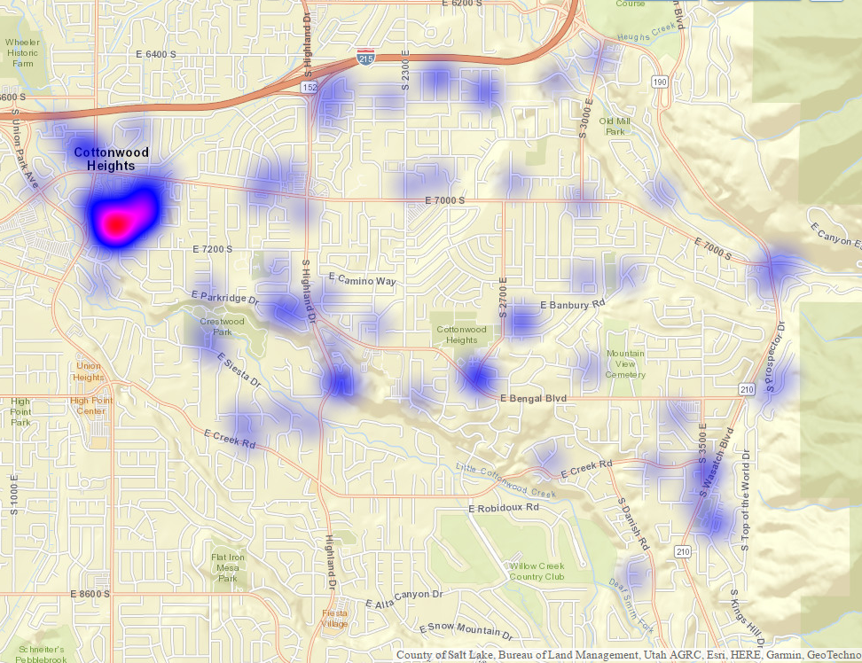
All Property Crimes Reports July 2022

Slide 14
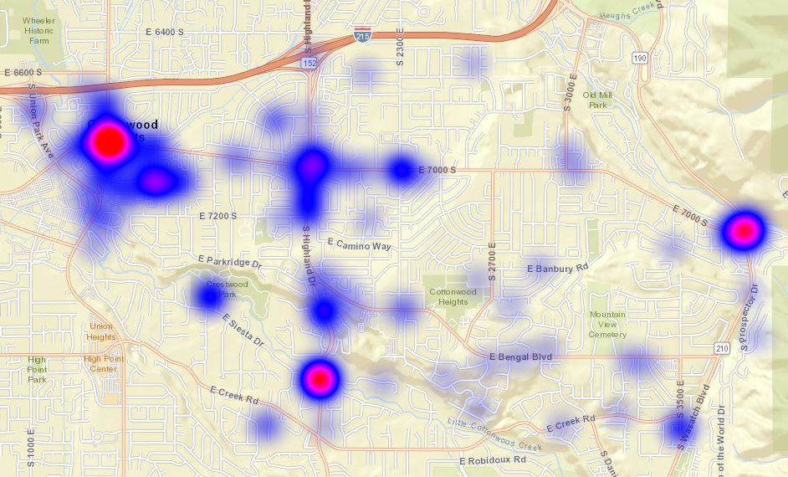
All Citations Issued July 2022

Slide 15
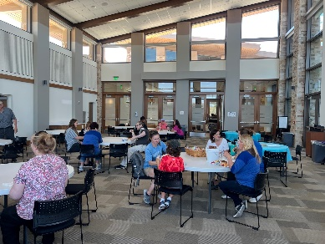
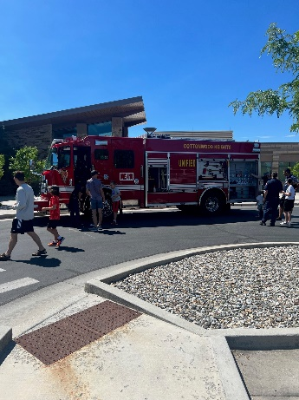
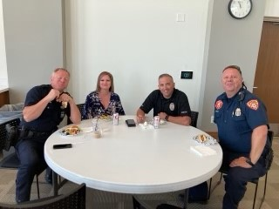
Food, Family & Fun with First Responders
On July 16, 2022, CHPD along with Unified Fire Authority and Autism Council of Utah hosted an event for the community. They had food, games and lots of interaction with the first responders of Cottonwood Heights.

Slide 16
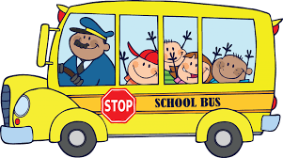
Back to School
Walking to school
Review your family’s walking safety rules and practice walking to school with your child
Walk on the sidewalk, if one is available; when on a street with no sidewalk, walk facing the traffic
Before you cross the street, stop and look left, right and left again to see if cars are coming
Make eye contact with drivers before crossing and always cross streets at crosswalks or intersections
Stay alert and avoid distracted walking
Riding a bicycle to school
Teach your child the rules of the road and practice riding the bike route to school with your child
Ride on the right side of the road, with traffic, and in single file
Come to a complete stop before crossing the street; walk bikes across the street
Stay alert and avoid distracted riding
Make sure your child always wears a properly fitted helmet and bright clothing
Preventing backpack-related injuries
Choose a backpack for your child carefully; it should have ergonomically designed features to enhance safety and comfort
Ask your child to use both straps when wearing their backpack to evenly distribute the weight on their shoulders
Don’t overstuff a backpack; it should weigh no more than 5 to 10 percent of your child’s body weight
Rolling backpacks should be used cautiously since they can create a trip hazard in crowded school hallways
Courtesy of NCS

